Slide 1
Information theory and criterion
Additions to Linear Models

Slide 2
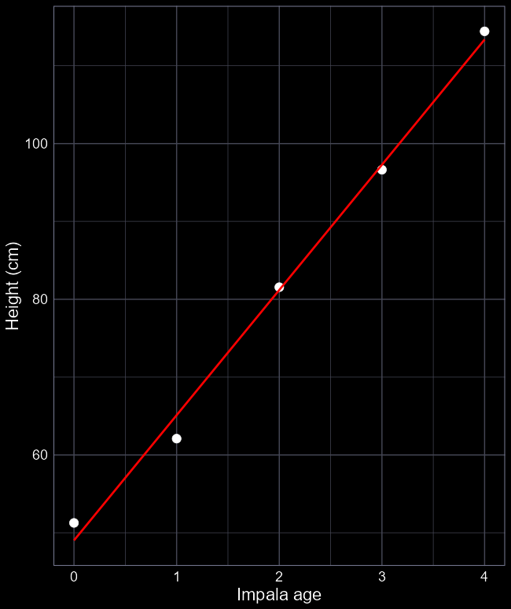
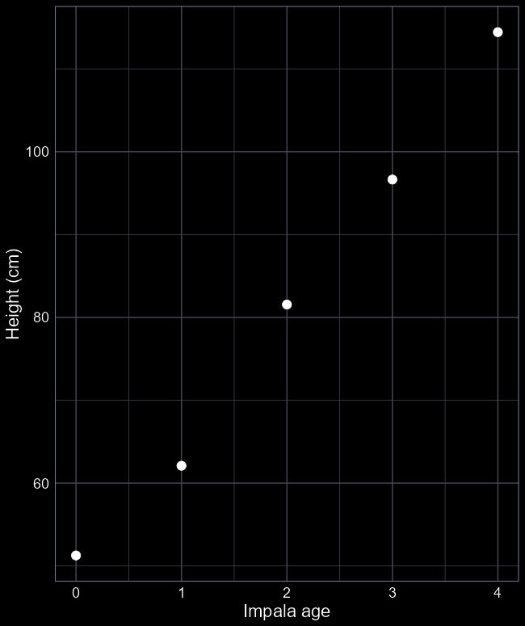
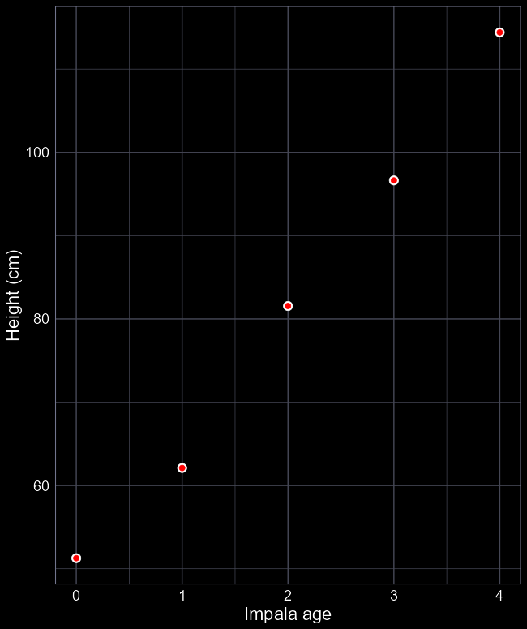
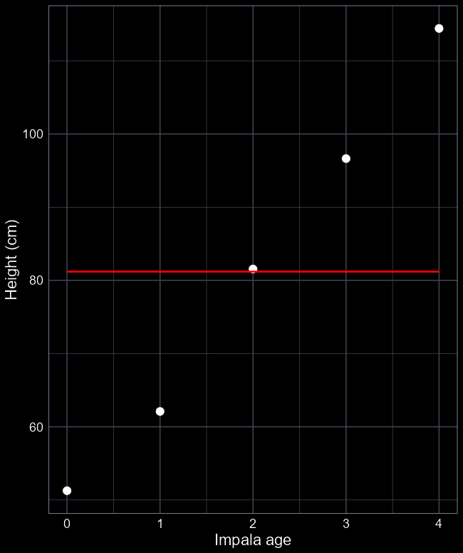
Overfitting and underfitting
We have height data of an individual impala from ages 0 to 4
Model 1:
lm(height ~ age_factor)
5 parameters
Model 2:
lm(height ~ 1)
1 parameter
Model 3:
lm(height ~ age)
2 parameters

Slide 3
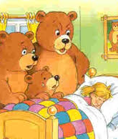
Parsimony
Overfit:
Explains data almost “perfectly”
I.e. predictions are exactly the same as the data
But “costs” lots of parameters
Underfit:
Explains poorly
I.e. prediction (line) doesn’t really match the observations
But is very “cheap”
E.g. here we’ve used 2 parameters with only 5 observations

Slide 4

Which model best fits our data?
When running analysis, you will invariably have multiple models (each of which reflect a different process), all trying to explain the same pattern, e.g.,
Out of all the models (i.e., processes) that we’ve run, how do we choose the most likely model?
AIC
“An Information Criteria” or “Information Criterion A”
“Improperly” called Akaike’s Information Criteria
He never named it after himself
赤池 弘次, Akaike Hirotsugu

Slide 5
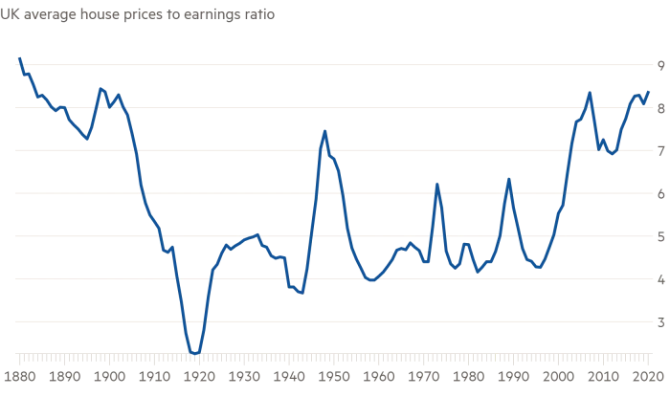
Using AIC to find most the “parsimonious” model
To do so, we use the best Likelihood (MLE) value (“rating”) for each of the different models that we’ve run.
Though we need to tweak the Likelihood
(and we’ll use this to choose which house we’ll buy)

Slide 6
Likelihood?
We’ve been using likelihood the whole course
The optimiser tries to maximise this for each set of parameters for each model
This happens for:
Model 1: lm(height ~ age_factor)
Model 2: lm(height ~ 1)
Model 3: lm(height ~ age)

Slide 7
Maximised Likelihood
Once the algorithm has finished, it tells us what the best likelihood was that it could find
So long as we use the same data to fit each model, we use the likelihood as our “rating”
But how do we deal with over- and under-fitting?

Slide 8

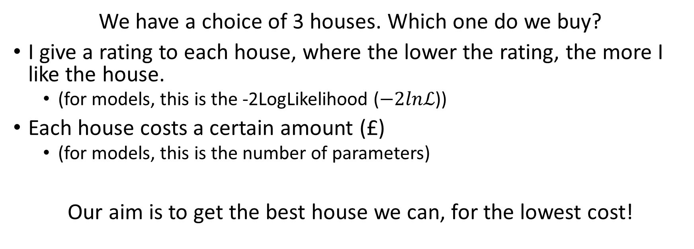
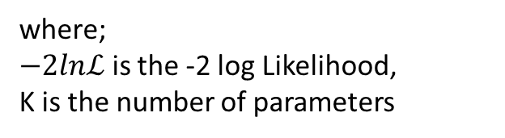
Savvy house buyers
We have a choice of 3 houses. Which one do we buy?
I give a rating to each house, where the lower the rating, the more I like the house.
(for models, this is the -2LogLikelihood ($−2lnℒ$))
Each house costs a certain amount (£)
(for models, this is the number of parameters)
Our aim is to get the best house we can, for the lowest cost!
$$AIC=−2lnℒ+2K$$
where;
$−2lnℒ$ is the -2 log Likelihood,
K is the number of parameters

Slide 9
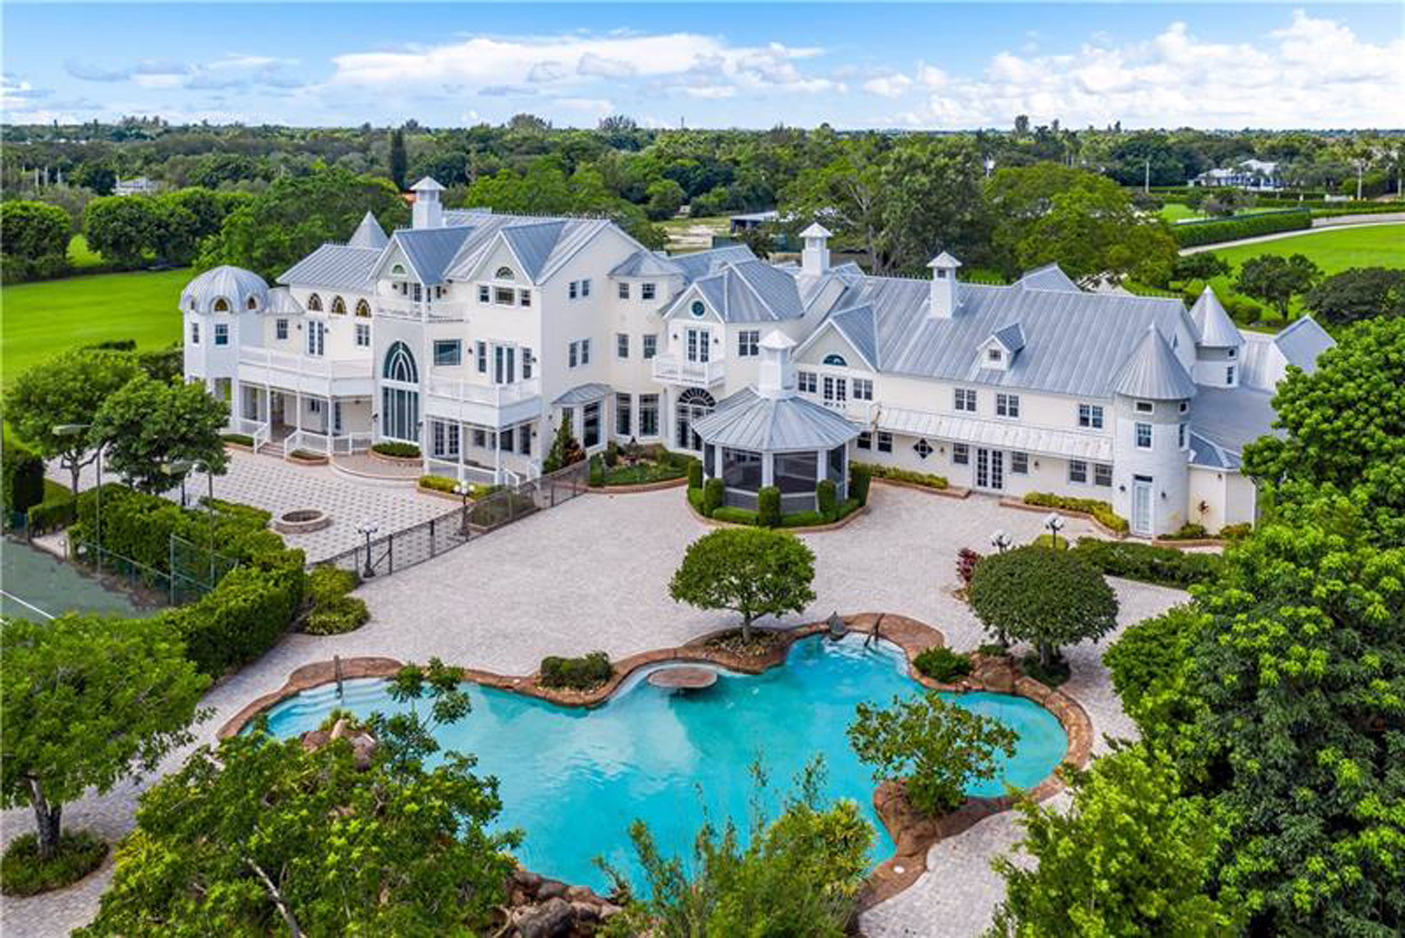
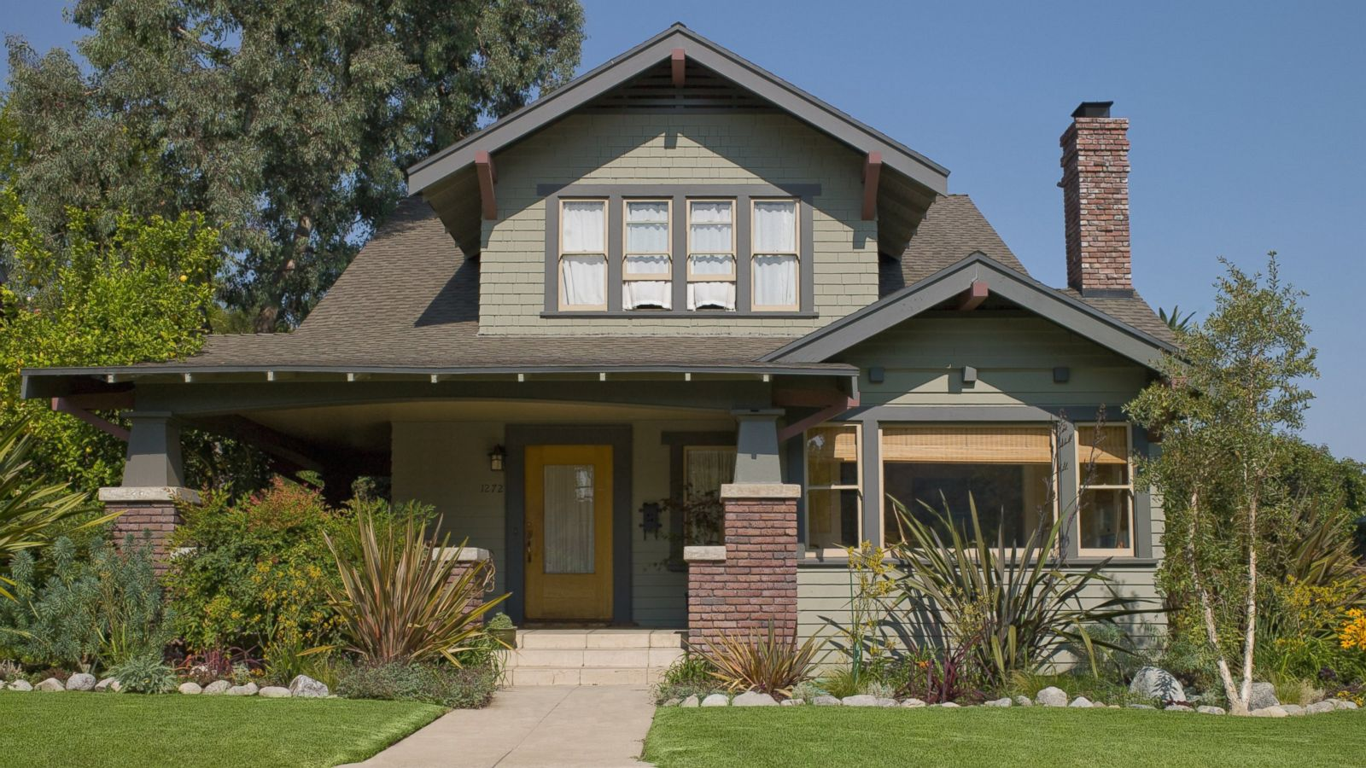


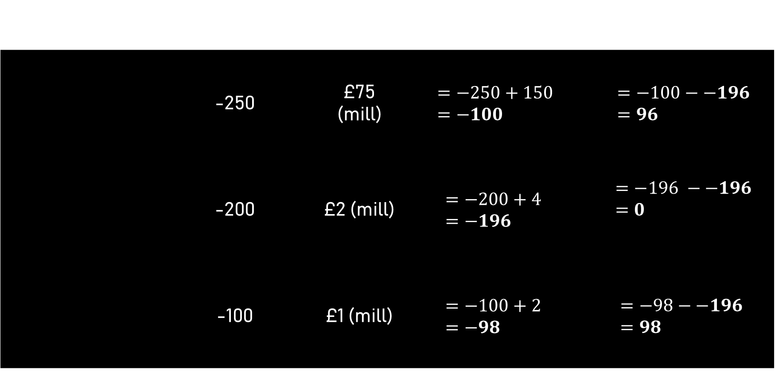
Let’s buy a house
The house | Deon’s Rating (-2lnL) | Cost (K) | AIC | ∆AIC
 | -250 | £75 (mill) | $$=−250+150 =−100$$ | $$=−100−−196=96$$
 | -200 | £2 (mill) | $$=−200+4 \\ =−196$$ | $$=−196 −−196=0$$
 | -100 | £1 (mill) | $$=−100+2 \\ =−98$$ | $$=−98−−196 =98$$
$$AIC=−2lnℒ+2K$$

Slide 10
Model selection with AIC
We select the model with the lowest AIC
This will be the model where ∆AIC = 0
Any models with ∆AIC > 2, we reject them
If there are models with ∆AIC < 2, both models are valid.
Some people argue to always choose the lowest
Other argue that you choose which one to use
No more p-values!

Slide 11
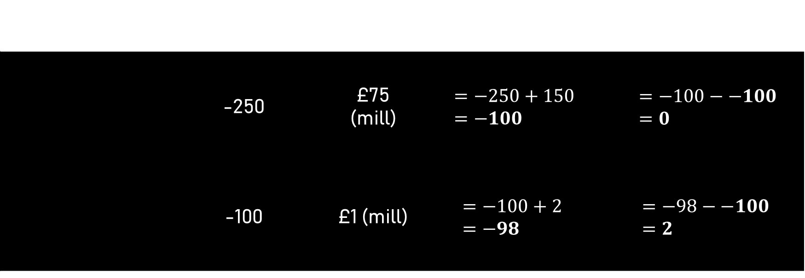

Which house do we choose now?
The house | Deon’s Rating (-2lnL) | Cost (K) | AIC | ∆AIC
 | -250 | £75 (mill) | $$=−250+150 =−100$$ | $$=−100−−100 \\ =0$$
 | -100 | £1 (mill) | $$=−100+2 \\ =−98$$ | $$=−98−−100 \\ =2$$
$$AIC=−2lnℒ+2K$$

Slide 12
tl;dr
We can use the MLE of each model to find the most parsimonious model that was tested.
If two of your lowest models have a ∆AIC ≤ 2 (e.g., 0 and 1.2), you cannot use AIC to distinguish between them.
AIC is a method to distinguish between models, but it doesn’t mean you can turn your brain off! Trust your biological training!

